Slide 1
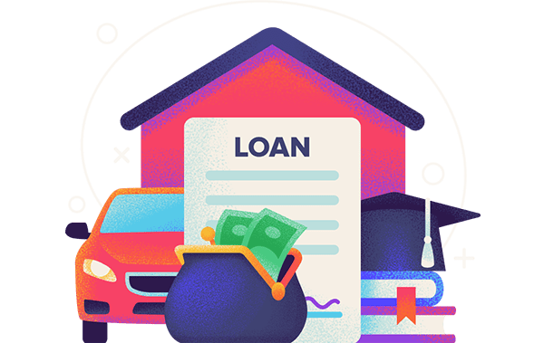
PREDICTING BANK LOAN ELIGIBILITY USING MACHINE LEARNING MODELS

Slide 2
ABSTRACT
The prediction of loan eligibility is a critical task for financial institutions, directly impacting their earnings and the accuracy of credit scores. With the increasing volume of loan applications, traditional methods of eligibility assessment are becoming inefficient and may fail to correctly identify suitable loan recipients, leading to higher financial risks.
This study investigates the application of Artificial Intelligence (AI) techniques, specifically Machine Learning (ML) to predict loan eligibility more accurately and efficiently.
We explore the performance of several ML classification algorithms (Gaussian Naive Bayes, AdaBoost, Gradient Boosting, K Neighbors Classifier, Decision Trees, Random Forest, and Logistic Regression).
Additionally, the study integrates Ensemble Methods and SMOTE with SMOTE-TOMEK techniques to address class imbalance, improving model effectiveness. The models are evaluated using four key metrics: accuracy, precision, recall, and F1-measure.
These findings demonstrate the potential of AI-driven predictive models to enhance loan eligibility assessments, reduce financial risks, and optimize credit scoring in the financial industry.

Slide 3
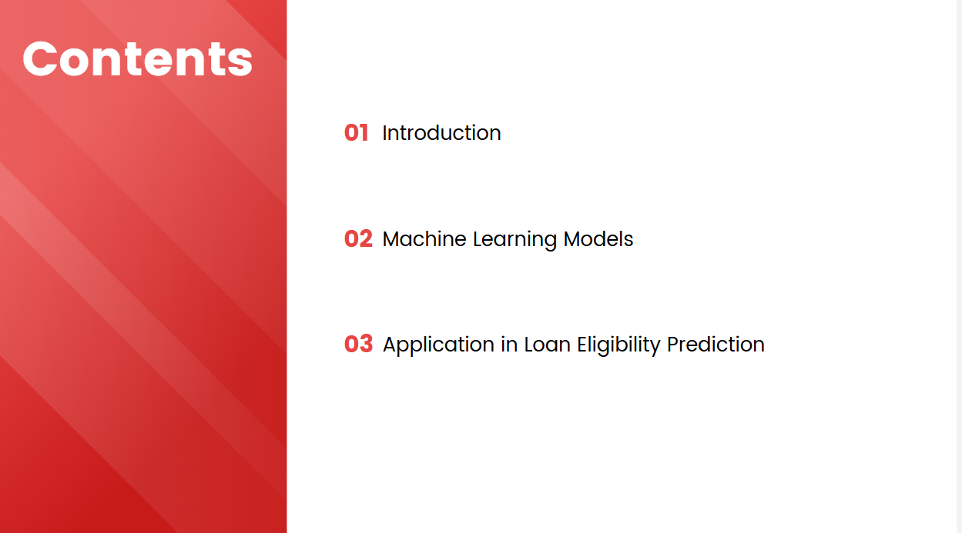

Slide 4



Slide 5
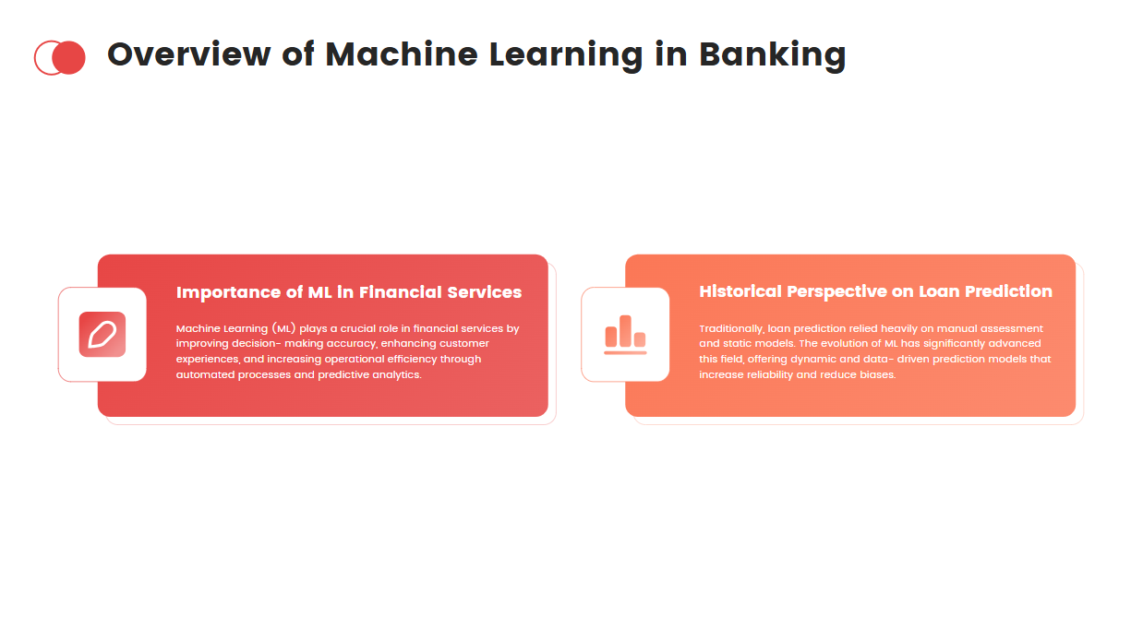

Slide 6
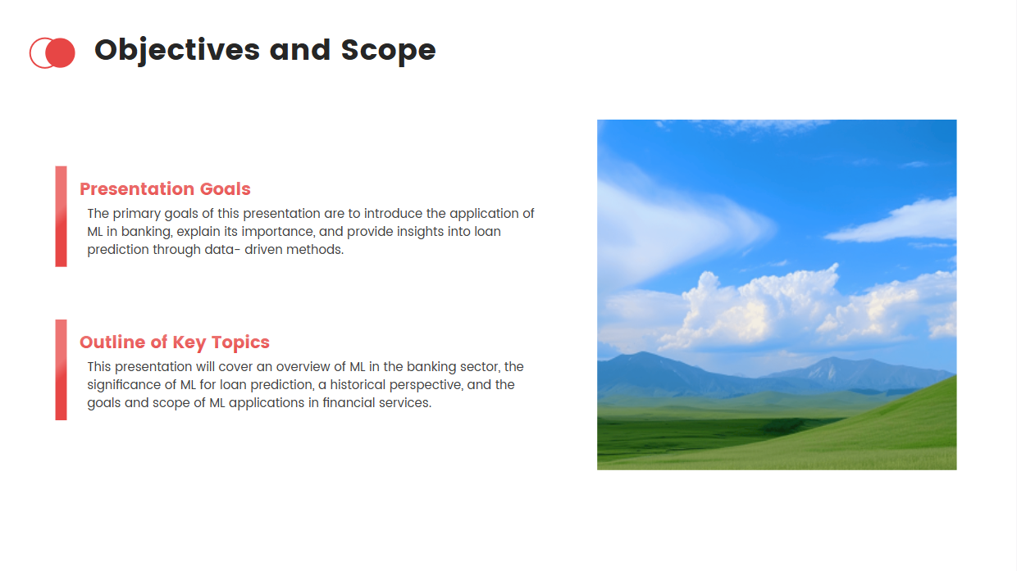


Slide 7

Machine Learning Models

Slide 8
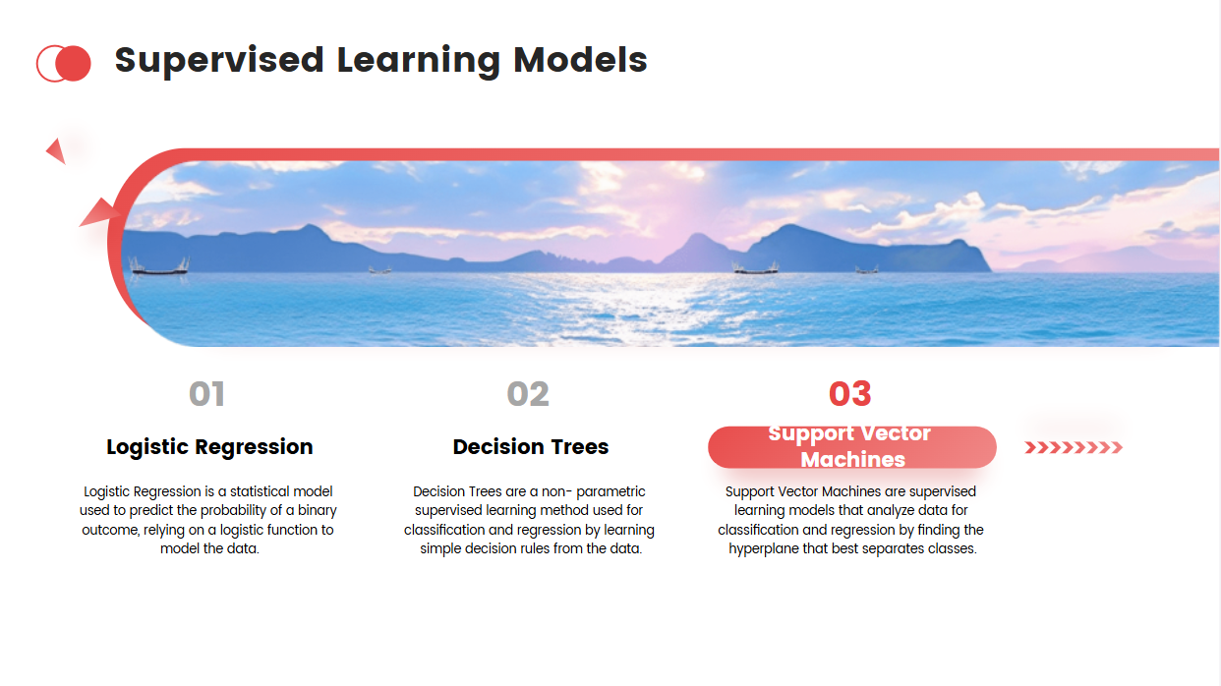
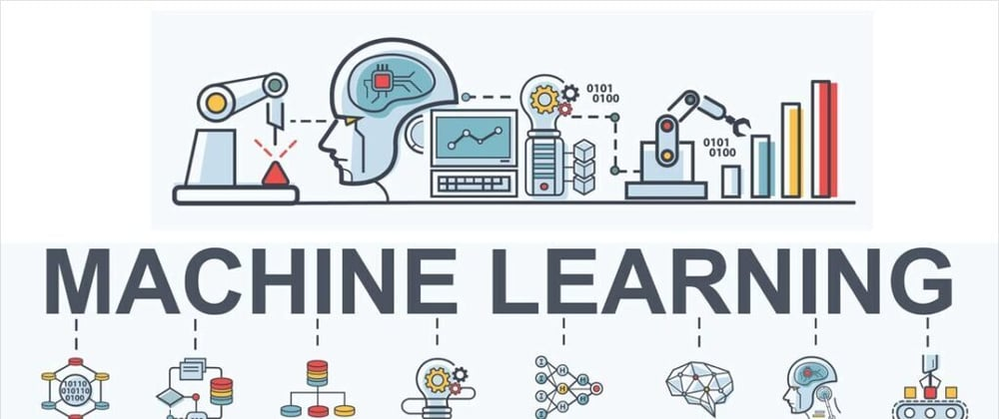

Slide 9
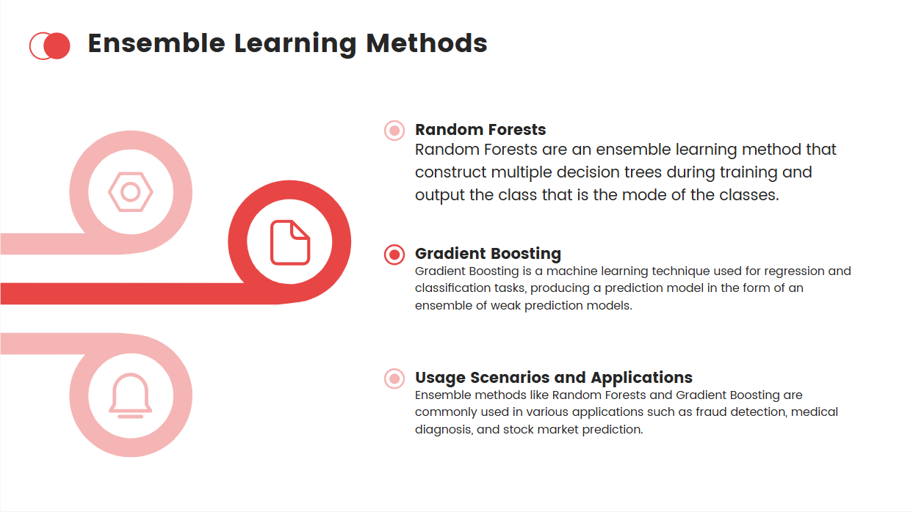

Slide 10

Steps involved in creating Loan Eligibility Prediction Model

Slide 11
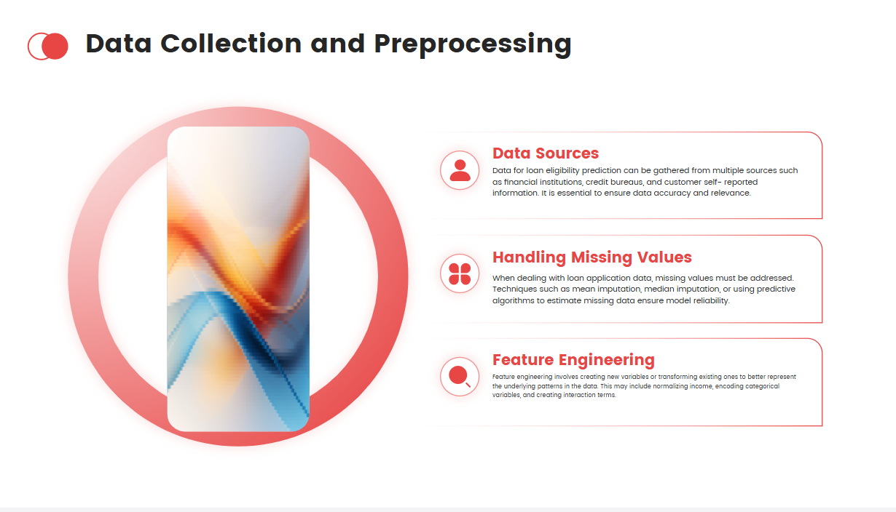
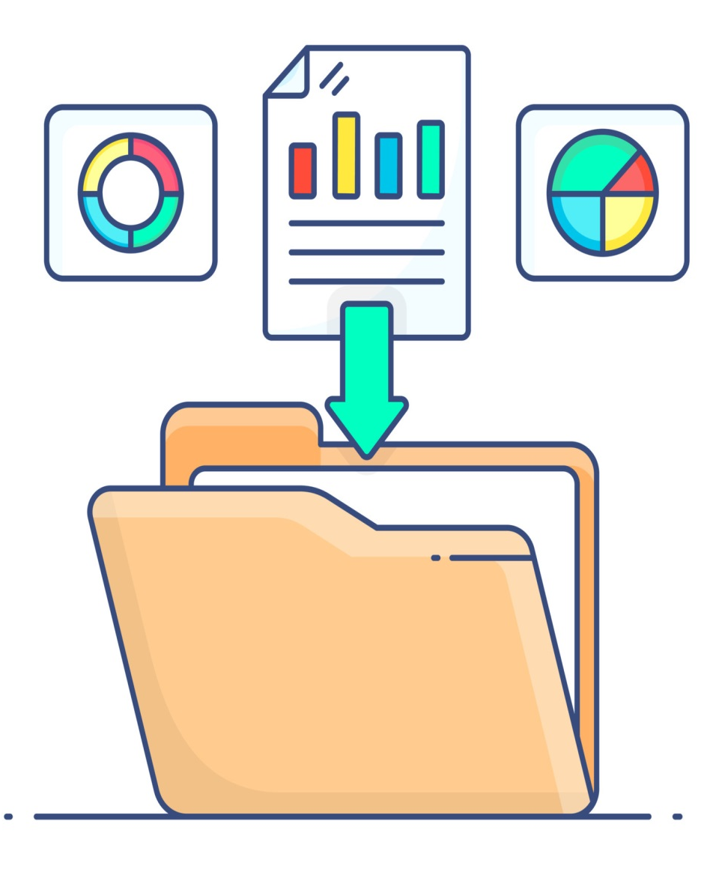

Slide 12
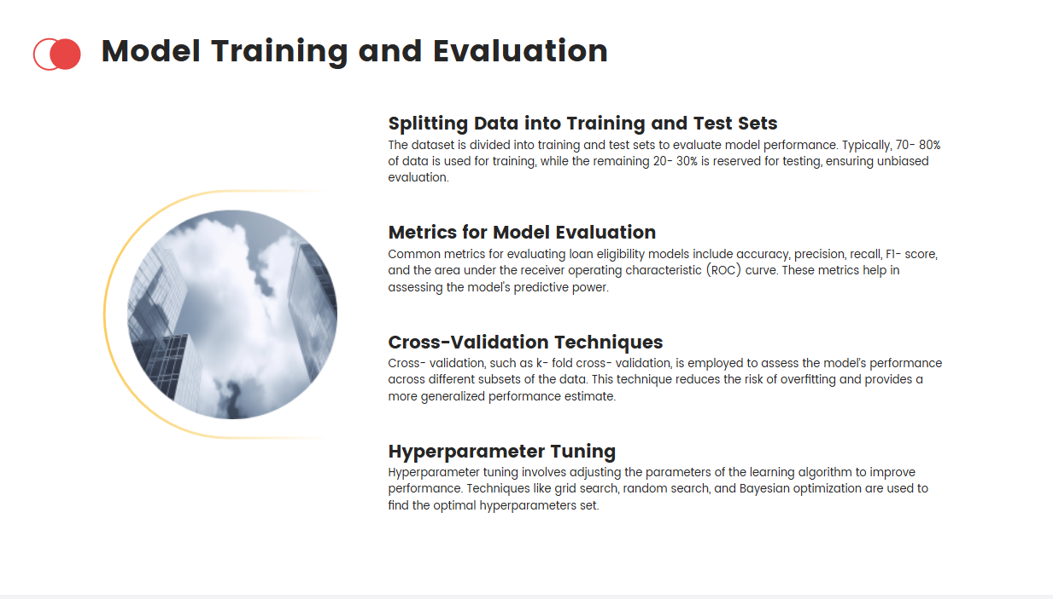
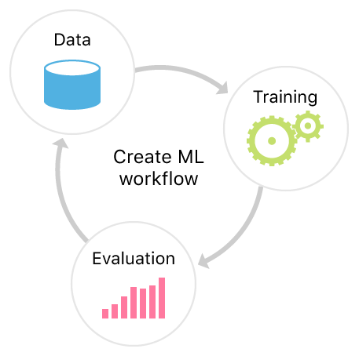

Slide 13
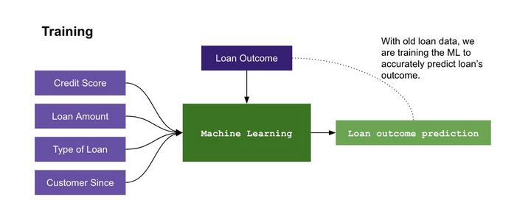
Model Creation

Slide 14
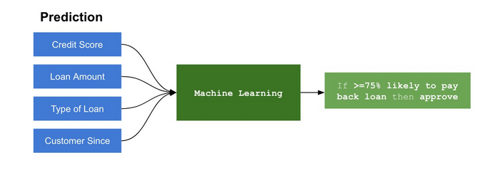
Deployment Stage

Slide 15
Advantage:
Easy to Select the Eligible Candidate to Issue Loans Without any Major Loan Default Risk
Reduces Traditional Manual Human Effort

Slide 16
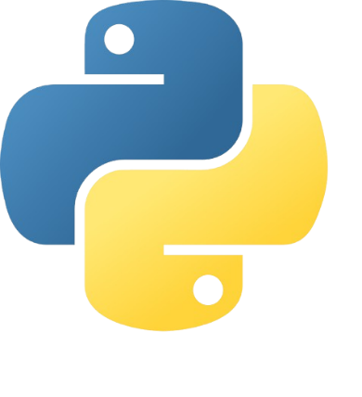
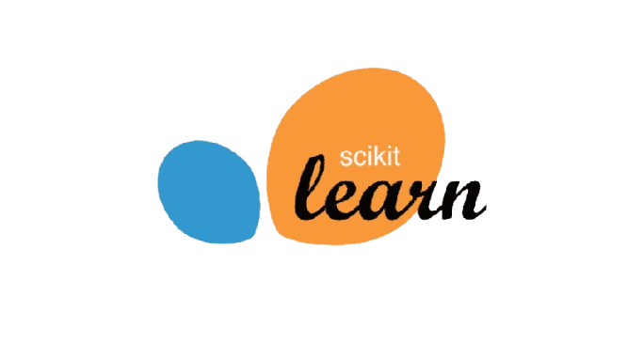
Software Requirement
Python
Django (Web Framework)
Library Used
Scikit-learn
Pickle
Numpy
Pandas

Slide 17
Project Done By : THANIGAIVEL G
THANK YOU
Project Guided By :
DR. A .MANIKANDAN
Mrs. KALPANA

